Slide 1


Navajo Nation Municipal Water Reuse Feasibility Analysis
2023 Arizona NASA Space Grant Statewide Symposium
Lauren Vasquez ª , Chris Yazzie ^{b}, and Vasiliki Karanikola ^{b}
ª Department of Biosystems Engineering, University of Arizona, Tucson, AZ 85721, USA
^{b} Department of Chemical and Environmental Engineering, University of Arizona, Tucson, AZ 85721, USA

Slide 2
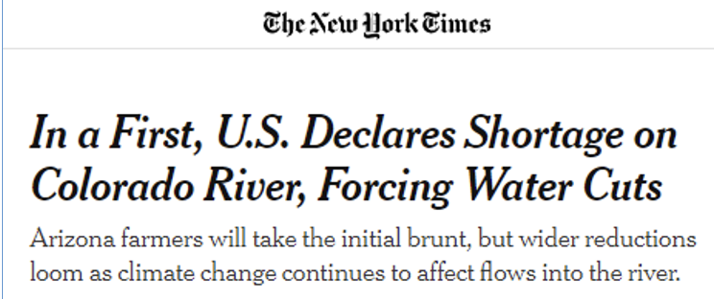
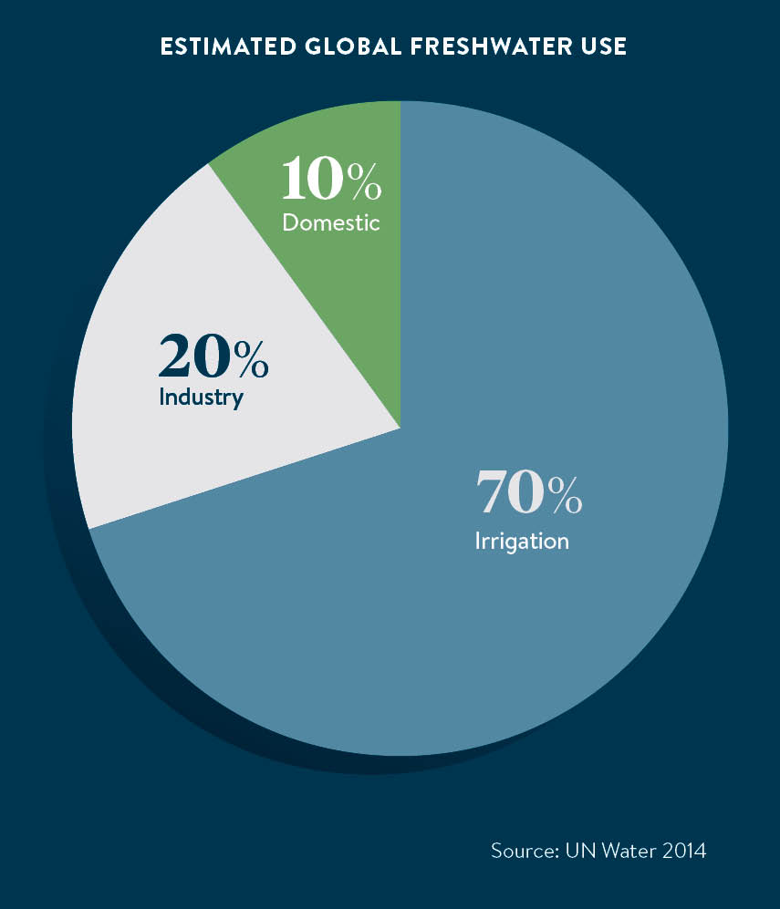
Background
Water scarcity is a growing challenge worldwide!
  Threatens our livelihood and food security
One solution is wastewater reuse
  Different treatment technologies produce different water qualities
  More advanced technologies are typically more expensive
https://www.nytimes.com/2021/08/16/climate/colorado-river-water-cuts.html#:~:text=With%20climate%20change%20and%20long,mostly%20will%20affect%20Arizona%20farmers.
  Multiple country and state guidelines and regulations
    Treated wastewater, or treated effluent, can contain beneficial nutrients as well as harmful ones
  Agriculture is the world’s largest consumer of freshwater
    Can utilize nutrients in the water
    Different crops have varying tolerances to nutrients
https://www.raconteur.net/worldwide-water-crisis-is-looming/
Notes:
-Water scarcity is a growing challenge worldwide. It is a problem right now and it threatens our livelihood and food security.
-One solution is wastewater reuse. Wastewater can be treated and used for variety of purposes. Different technologies produce different water qualities. More advanced technologies , that produce a higher water quality, are typically more expensive..
-There are multiple federal and state regulations guidelines for the use of treated wastewater throughout the world. The reason for this is that treated wastewater, also known as treated effluent, can contain beneficial nutrients, as well as harmful ones.
-Agriculture is the world’s largest consumer of freshwater, as you can see on the graph. Agriculture is a good reuse purpose since Treated wastewater contains fertilizing nutrients which can be used to enhance crop growth and reduce the need for additional fertilizer, having both financial and environmental benefits. However, different crops have different tolerance to said nutrients.

Slide 3
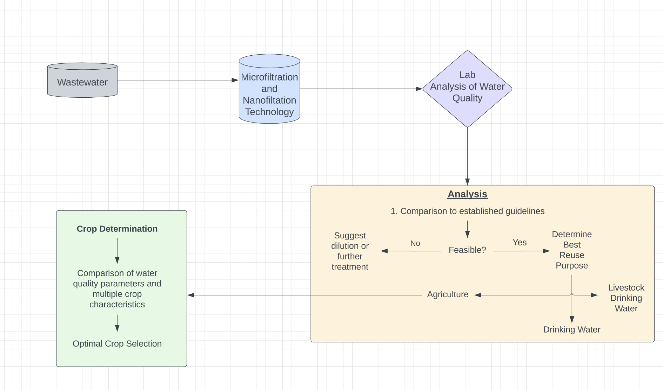
Project Objectives
Objectives
Analyze water quality pre and post membrane treatment
Collect worldwide federal and state guidelines
Develop a solution framework to assist decisions for treated wastewater quality
✓
✓
Notes:
-This is an outline of the objectives of our project. We take treated wastewater samples, from the Navajo Nation, and run them through our bench microfiltration and nanofiltration system.
-We then analyze these samples for these different constituents in the lab. Once we’ve received the lab data, we can evaluate the water quality compared to established guidelines throughout the world.
-From the guidelines, we can determine the feasibility of the treated wastewater. If it is feasible, we determine the best reuse. We evaluate for livestock drinking water, human drinking water, and agriculture. If agriculture if selected, we aim to be able to suggest the best crop for a certain water quality, to make use of the nutrients in the water without hindering crop growth and yield.
-The lab group mostly analyzed the water quality post and pre treatment before I joined. However, throughout the year, I focused mainly on collecting and analyzing the regulations and guidelines from around the world. In the future, we aim to construct a decision framework for specific water qualities using the databases we’ve been collecting.

Slide 4
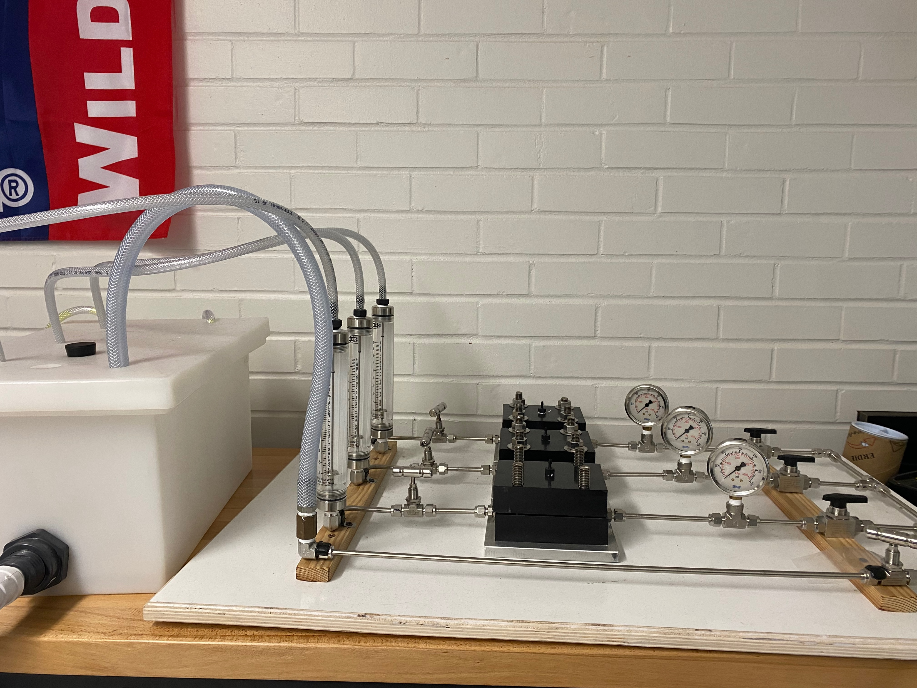
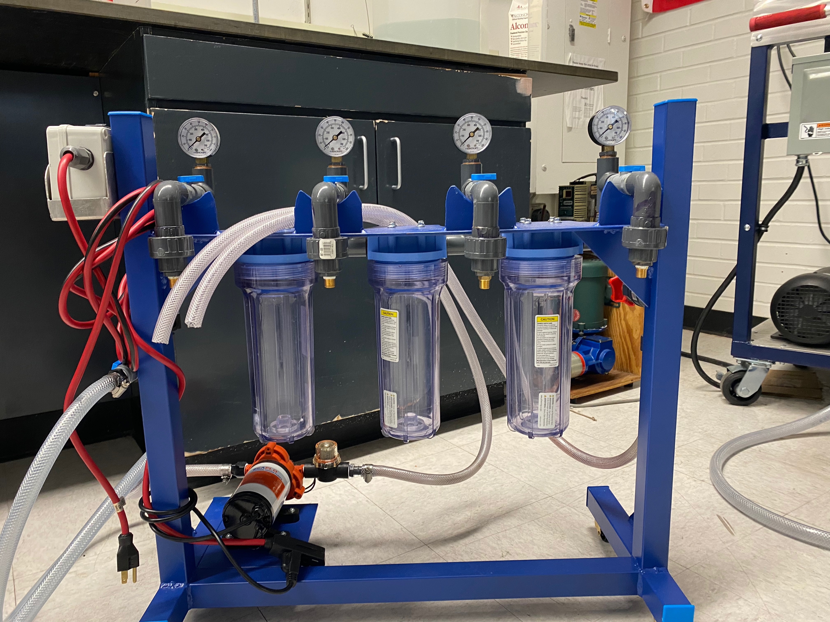
Water Quality and Treatment Analysis
To investigate the efficiency of our microfiltration and nanofiltration technology, effluent samples from the Navajo Nation were treated with a bench scale in the lab
Analysis of pre- and post-treatment for samples
  Used ion chromatography (IC) to test for 12 inorganics, inductively coupled plasma mass spectrometry (IC- PMS) for 20 metals, and liquid chromatography-mass spectrometry (LC-MS) for 38 contaminants of emerging concern (CECs)
  Tested for 72 constituents in total
Notes:
** Add pic
The first objective we are going to discuss is the lab analysis of the water. Effluent samples from the Navajo Nation were treated using a bench scale of the membrane technology. We, then, tested the quality of the water pre and post treatment using different lab tools to test for different types of contaminants that could possibly be in the water. In total, we test the water samples for 72 possible constituents.

Slide 5
Literature Review for Water Usage Regulations and Guidelines
Critical literature review
Evaluated various regulations and guidelines worldwide
Helped create a comprehensive and efficient feasibility framework
  Each guideline or regulation only covered a fraction of the constituents
    Including wastewater reuse and multi-purpose water quality guidelines
  Researched reasoning behind the established value
    For agriculture, guidelines vary based on many factors
    Ensures maximum water conservation and efficiency
Notes:
-A majority of my time this year went to conduct a critical literature review of regulations and guidelines. I compared and evaluated various regulations and guidelines worldwide.
-The purpose of finding multiple guidelines and regulations was to create a comprehensive and efficient framework to analyze for feasibility. Each guideline or regulation only covered a fraction of the constituents we test for , including wastewater reuse and water quality guidelines. Combining them all together for our analysis gave us values for most of the constituents we tested for. We wanted to ensure safety from the most constituents we could, even if Arizona didn’t have regulations for them.
- I also analyzed the reasoning behind the established value. Especially for agriculture, there are many factors that can affect the recommended value. Knowing these factors and how they effect the nutrient concentration and crop growth, can help ensure maximum water conservation and efficiency through our framework.

Slide 6
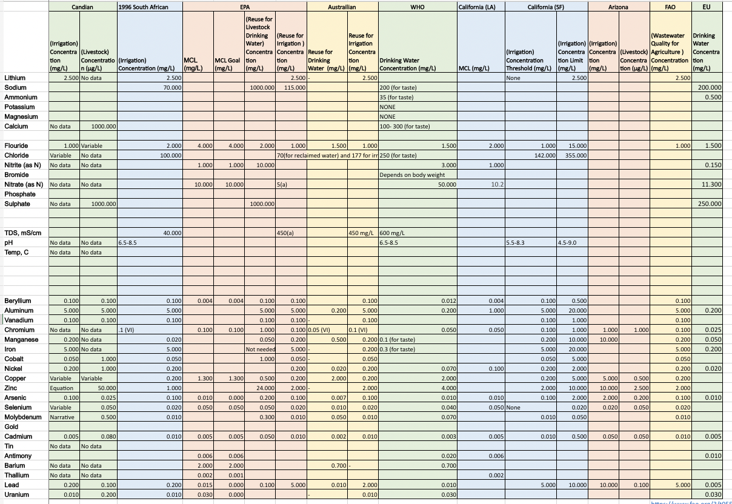
Literature Review for Water Usage Regulations and Guidelines
Notes:
-This is a database for the guidelines I collected for inorganics and metals we tested the water samples for in the lab. I included water reuse and multi-purpose water quality guidelines, including for drinking water and livestock. Our main focus is agriculture, but we collected values for livestock and drinking water to compare and determine the best reuse purpose.
-Through comparing guidelines for multiple purpose, we can determine the best reuse purpose for the specific water quality
-Multiple refs… put in?
-sHOW MULTIPLE GUIDELINES. Go quick
-Show how AZ doesn’t have rarely any
-GOLD? OR SILVER

Slide 7
Literature Review for Water Usage Regulations and Guidelines
Notes:
--This guideline is the irrigation water quality for Arizona. As you can see, Arizona has significantly less guidelines for irrigation than other states and countries around the world.

Slide 8
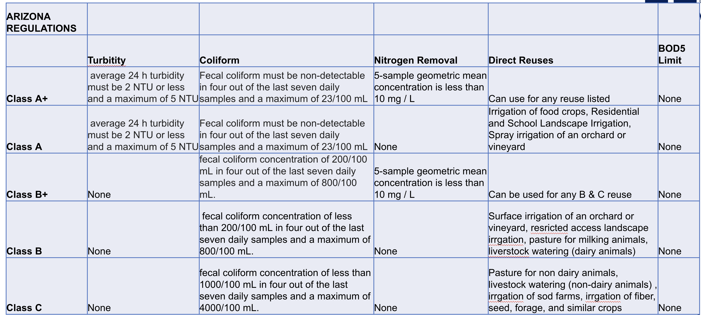
Arizona Regulations
Few parameters
https://www.epa.gov/sites/default/files/2014-12/documents/az-chapter11.pdf
Notes:
-These are the Arizona water reuse regulations. Once again, you can see there are very few parameters, most of which are not ones we analyzed for. In Arizona alone, a review of the regulations show there is a need to have a comprehensive framework to ensure maximum safety, because there are a lot of values they don’t discuss.

Slide 9
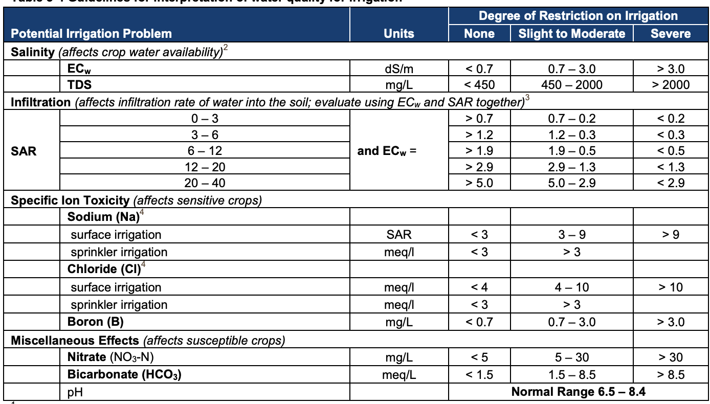
International Guidelines
Feasibility of certain water quality affected by irrigation method
https://www.epa.gov/sites/default/files/2019-08/documents/2012-guidelines-water-reuse.pdf
Notes:
-This is the EPA and FAO wastewater reuse guideline for agriculture. This guideline shows an example of the many factors that can affect the reuse of wastewater for irrigation . In this case, it is the irrigation method.

Slide 10
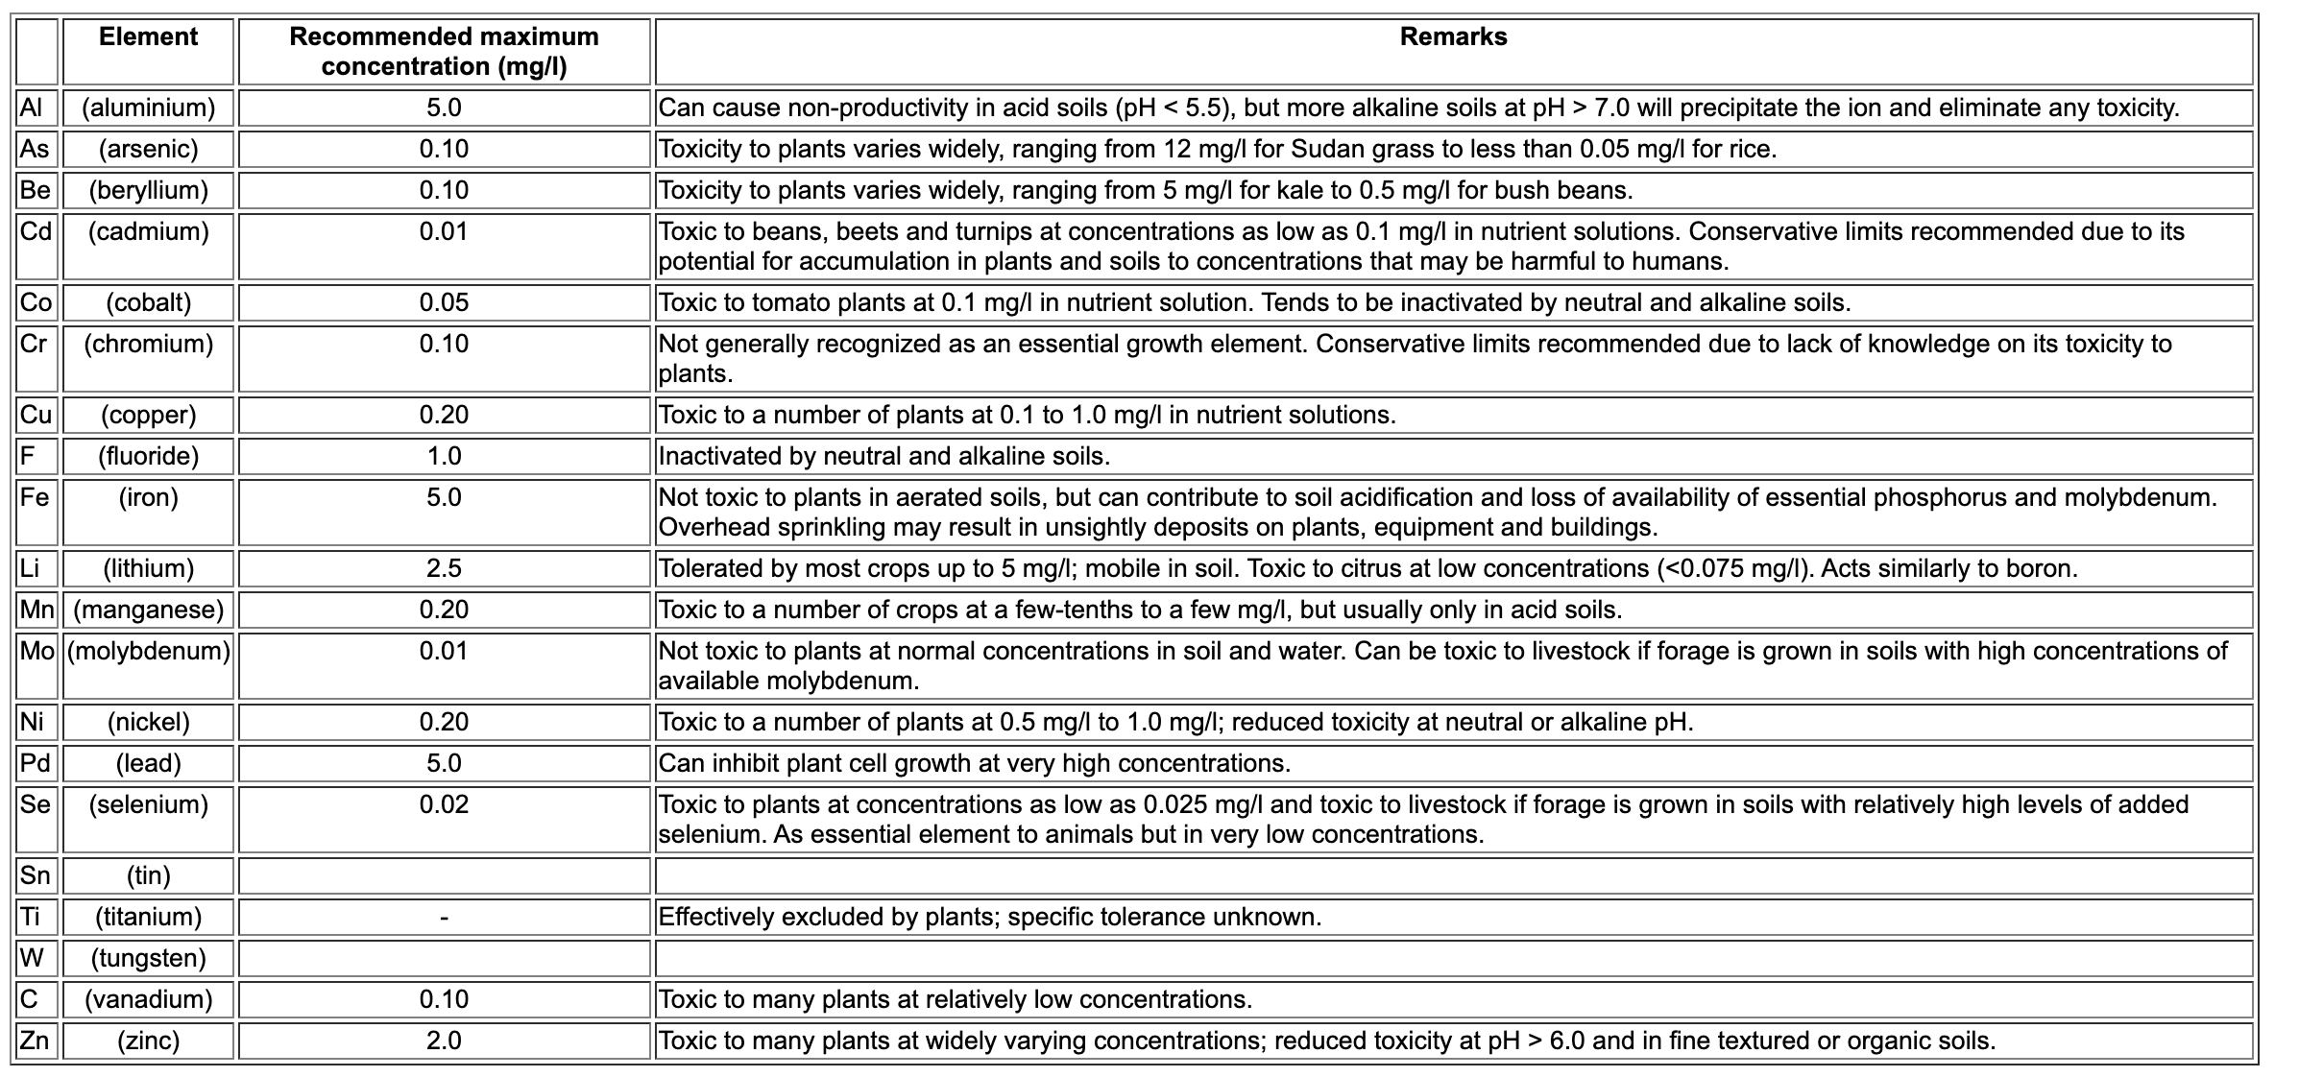
International Guidelines
Effect of metals varies based on crop selection
https://www.epa.gov/sites/default/files/2019-08/documents/2012-guidelines-water-reuse.pdf
Notes:
-Lastly, this is the EPA and FAO trace element guideline for wastewater reuse for irrigation . Once again, this guideline shows how factors can affect the feasibility of the water. In the remarks, you can see that the crop determines the effect of element. These guidelines shows the need for a comprehensive framework for users to ensure safety and efficiency when using treated wastewater.
#There are many factors that go into the effects of different constituents in the water and I have collected these as well.

Slide 11
Crop Determination
Treated water quality influences crop selected for planting
Designing for optimal growth and minimal additional application of resource
  Compare crops’ characteristics (nutrient tolerance) to the treated water quality (amount of nutrient contained)
  Account for different influencing factors such as irrigation method, period of growth, etc.
  Optimization of nutrient recovery
Analyzing for multiple popular crops in Arizona and the Navajo Nation
  Cotton, barley, wheat, lettuce, broccoli, onion, carrot, alfalfa, potato, strawberry, peach, grape, turfgrass, corn, tomato, legume, and watermelon
Notes:
-ALSO THRU CRIT FERVIEW
-That leads us into crop determination. Crop determination is a framework where the treated water quality influences the crop that is selected for planting, in order to obtain optimal growth of the crop and minimize additional application of fertilizer or freshwater.
We can do this by comparing specific crops characteristics, such as nutrient tolerances to the treated water quality. We will also take into account the different influencing factors, such as irrigation method, soil type, period of growth and more, to make our framework as accurate as possible.
The crop determination process optimizes nutrient recovery from the treated water , minimizing additional fertilizer and pollution from the nutrients .
-I analyzed and created a data base of crop information for multiple popular crops in Arizona and the Navajo Nation, which you can see on the screen.
###

Slide 12
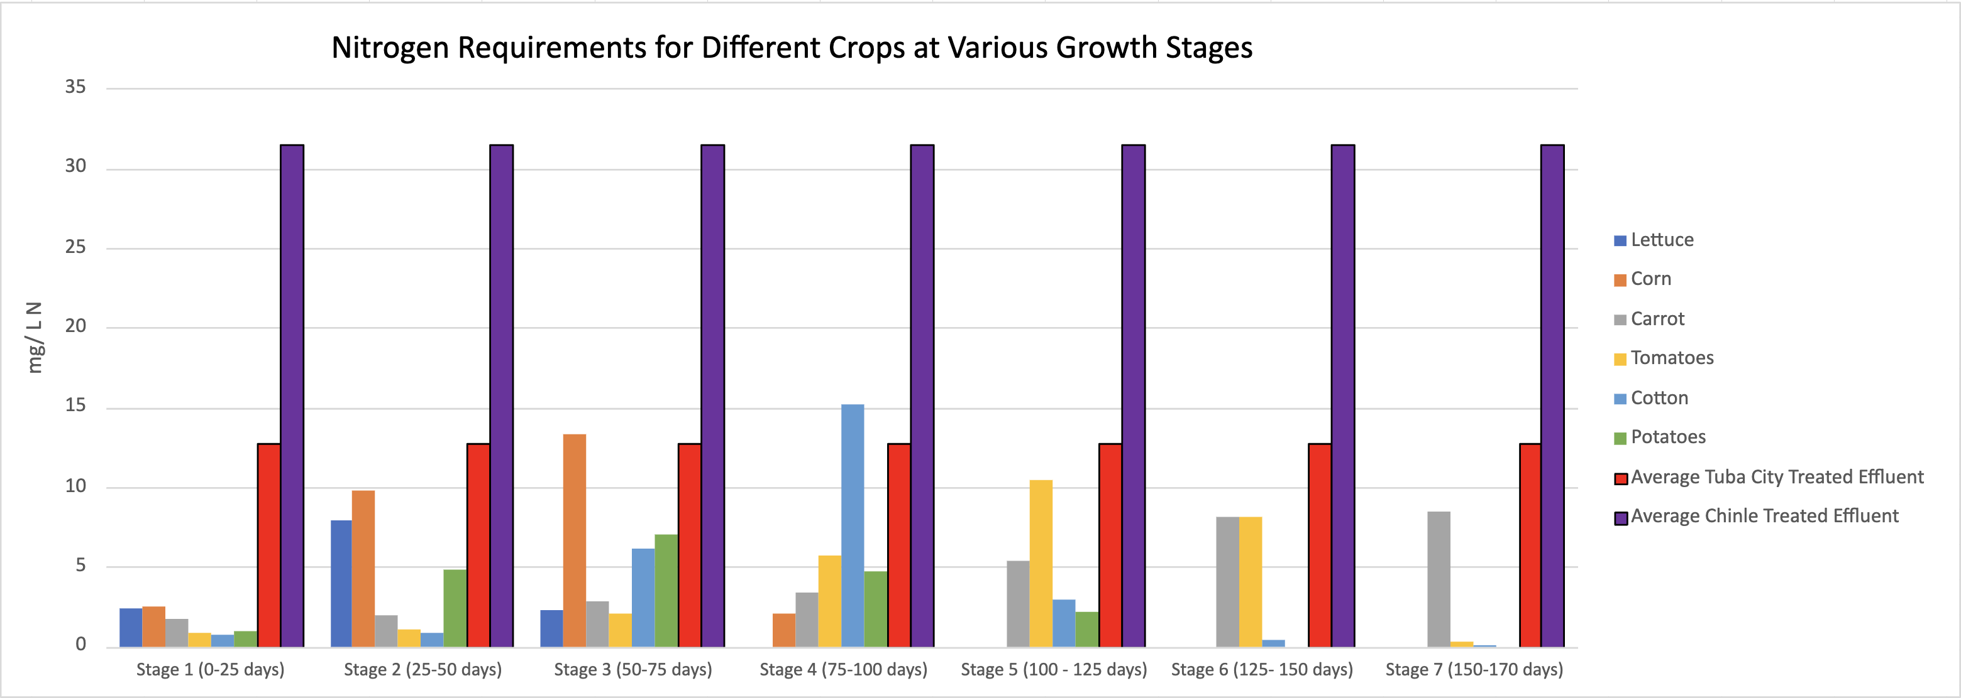
Crop Determination (Nitrogen)
Decreases the need for inorganic fertilizers and minimizes environmental consequences
  Many farmers don’t consider nutrients in treated wastewater and over-fertilize
  Suggest additional fertilizer or blending when necessary
Notes:
-An example of how crop determination will work is shown. Nitrogen is one of the most essential nutrients for plant growth, and the crop requirement varies based on the growth stage of the plant. When comparing the treated effluent values to the amount of nitogen needed at each stage for multiple crops, we can see that the N contained in the treated effluent was more than enough most of the time.
- Utilizing the N in the treated wastewater decreases the need for inorganic fertilizers and minimize environmental consequences.
-A common problem is the many farmers don’t consider the nutrients in treated wastewater and over fertilize, negatively impacting crop growth and polluting ground and surface water.
- Through this analysis, we can suggest additional fertilizer and blending at appropriate times. We will do this for most of the parameters we tested for.

Slide 13
Future Work- Framework for Crop Determination
Determine irrigation schedule for all crops and user inputs
Compare to all crop characteristics (period of growth, nutrient requirements and thresholds, etc.)
Calculate amount of each constituent applied based on irrigation schedule
Suggest optimal crop and offer schedule of blending and fertilizer application
Notes:
-An overview of the framework for crop determination is shown. First, we will determine the irrigation schedule for all crops and the user inputs, which include soil type, climate, treated water quality, and more .
Based on the irrigation schedule, we will calculate the amount of each constituent being applied at each irrigation.
-We will then compare the amount applied to crop characteristics in the data base, such as growth period and nutrient requirements and thresholds and more.
Based on evaluation of the parameters for all crops, we will suggest the best crop to produce optimal yield, and offer a schedule of blending and fertilizer application to ensure correct amounts are being applied throughout the whole season.

Slide 14
Conclusions
Microfiltration and nanofiltration membrane technology is a viable treatment options for treating secondary wastewater effluent for irrigation
Compilation of the database showed that there are a variety of water reuse regulations around the world which is important for assurance of public health
A solution framework shows many possibilities for the optimization of crop selection, nutrient recovery, and wastewater utilization
Notes:
-In conclusion, the Microfiltration and nanofiltration membrane technology is a viable treatment options for treating secondary wastewater effluent for irrigation. The treated water followed regulations and guidelines.
.-The compilation of the database show that there are a variety of water reuse regulations around the world that ensure the safety of the public from constituents in the water.
-Lastly, the solution framework shows many possibilities to optimize crop selection, nutrient recovery, and wastewater utilization, which can have positive financial, environmental and social effects.

Slide 15
Thank you!
To Space Grant for this opportunity, and everyone who has helped me on the way. A special thank you to Chris Yazzie and Vicky Karanikola for the guidance and encouragement throughout the year.

